Slide 1
Python – Strings
Shah Ayub Quadri
aquadri@digital-lync.com

Slide 2
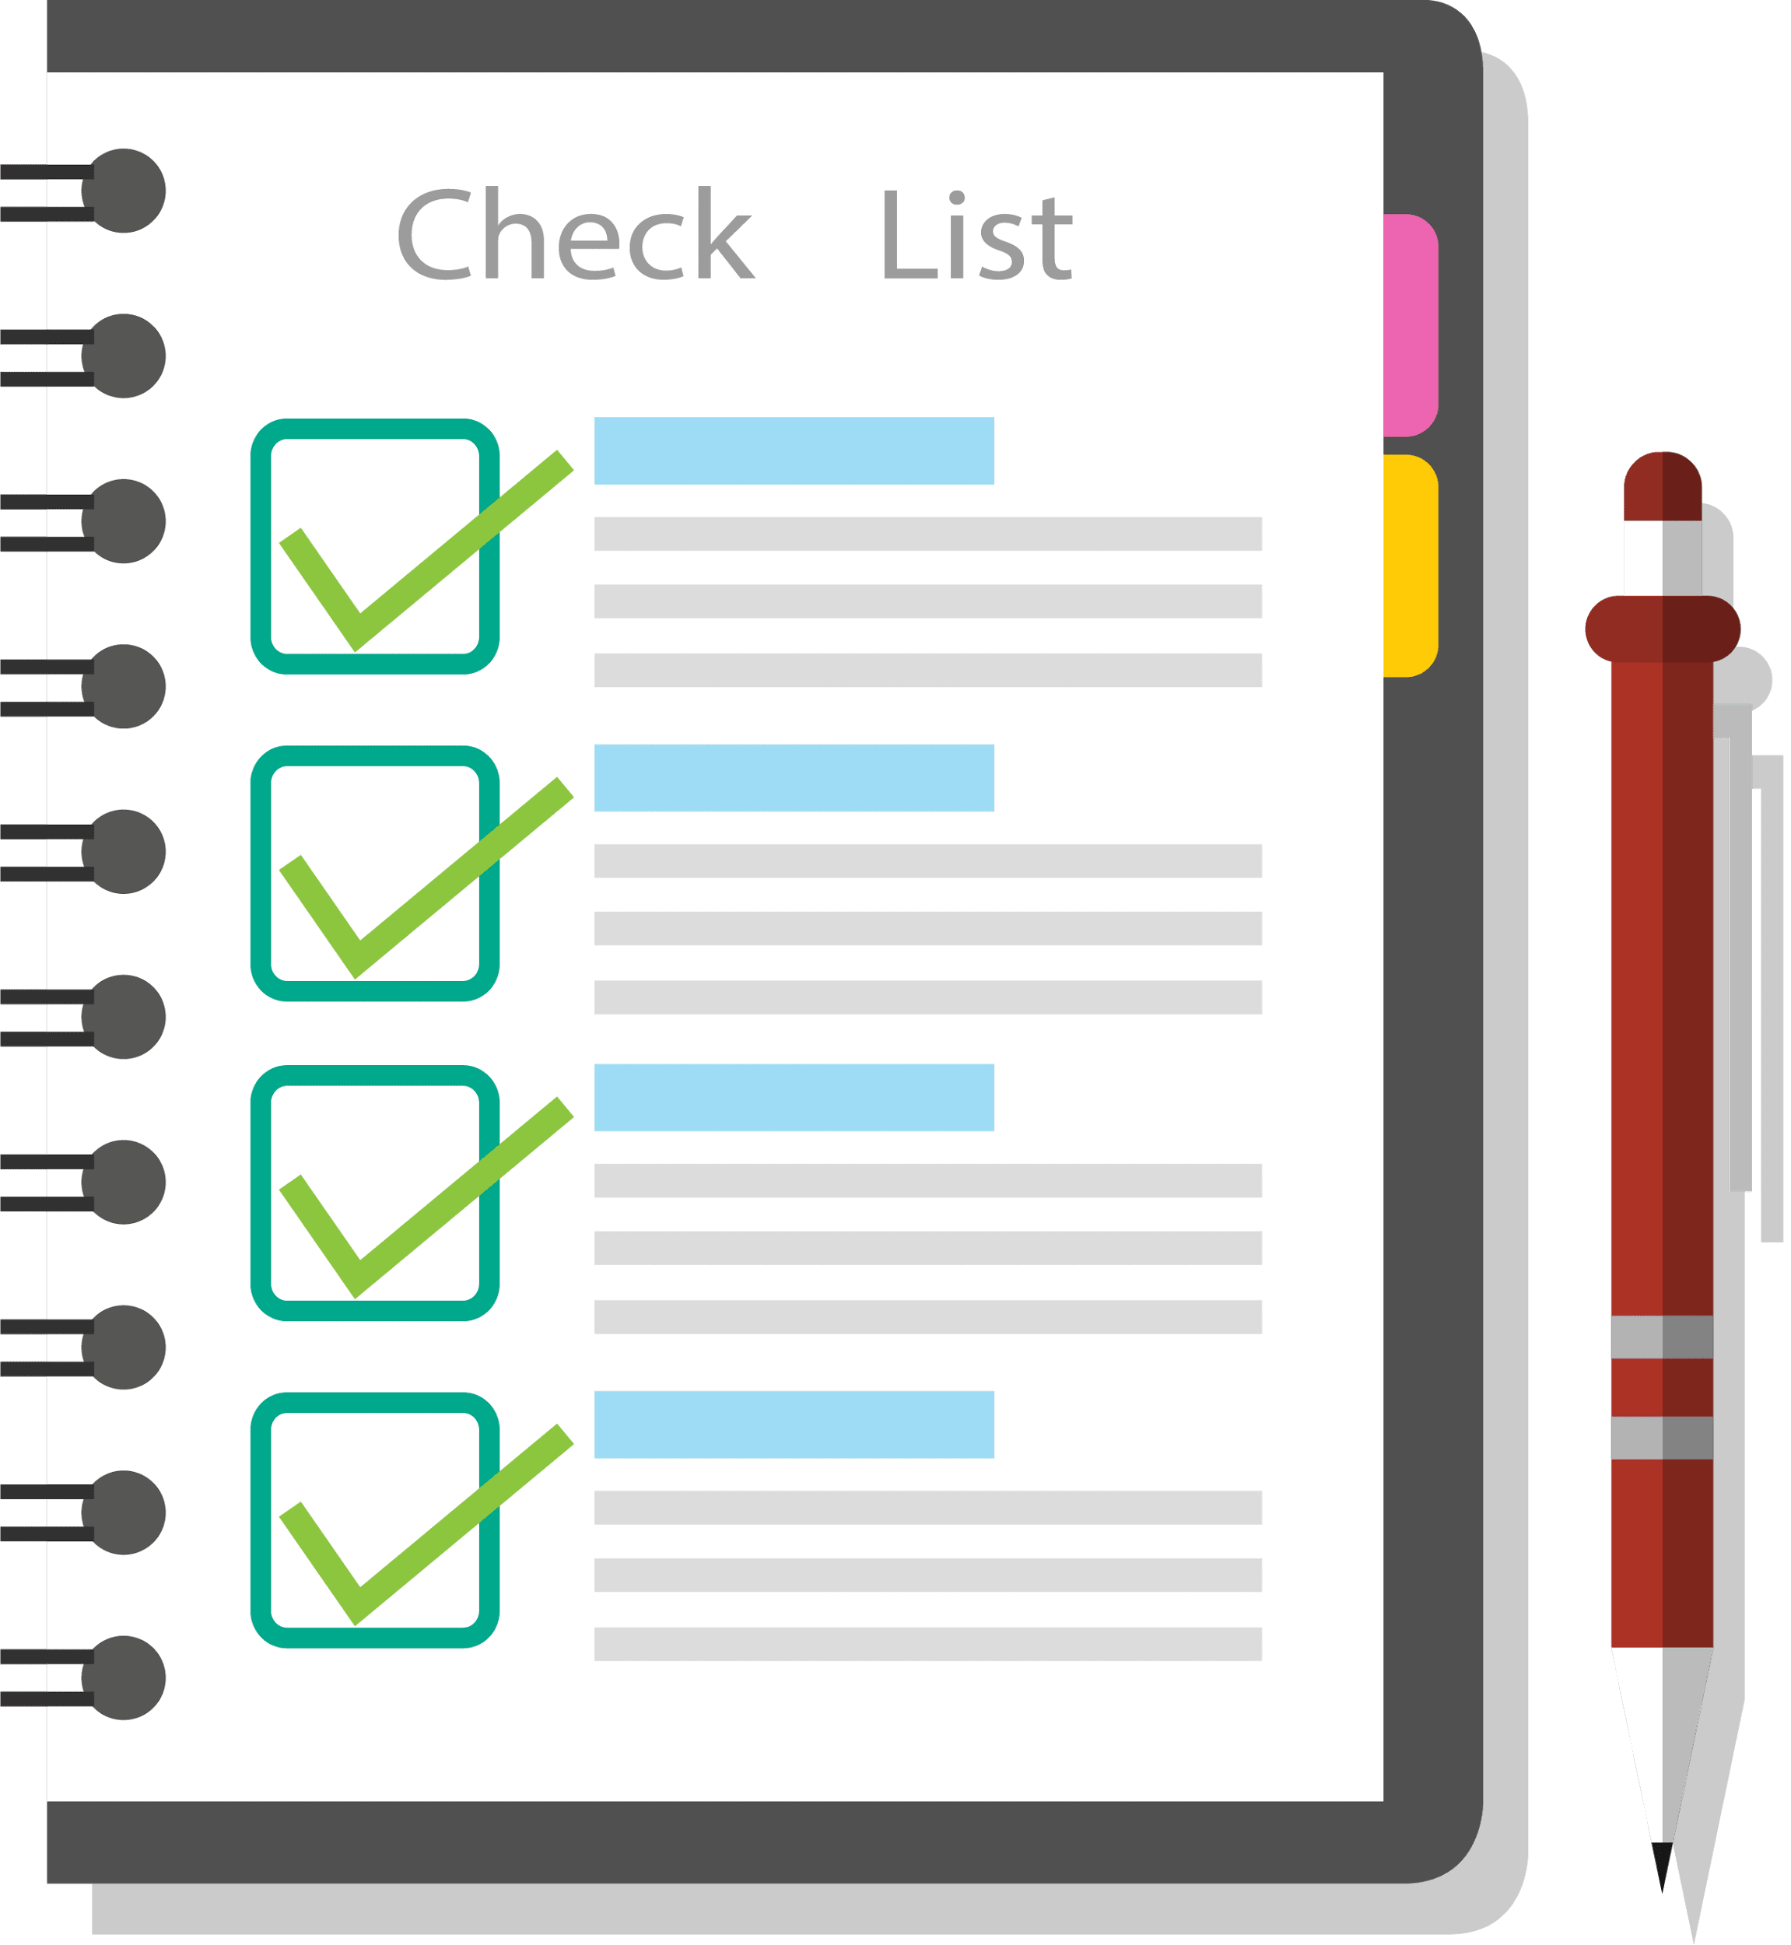
Index
Python Basics
What are Strings?
String Manipulation
• Accessing Strings
• Basic Operations
• String slices

Slide 3
What are strings?
Strings:
String is a sequential data type, which holds sequences of characters in it.
A character can be anything either Numeric or Alphabet.
Strings can have spaces: "hello world".
An empty string is a string that has 0 characters.
Python strings are immutable
Python recognize as strings everything that is delimited by quotation marks (" " or ' ').

Slide 4




String Manipulation
To do string manipulation, we can use some of Pythons built-in methods.
Python has a lot of built in methods that allow us to easily manipulate (change) strings
Creation:
Accessing :
Use [ ] to access characters in a string

Slide 5


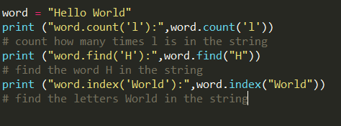

String Manipulation
Length:
The len method counts the number of characters in a string.
Finding:

Slide 6


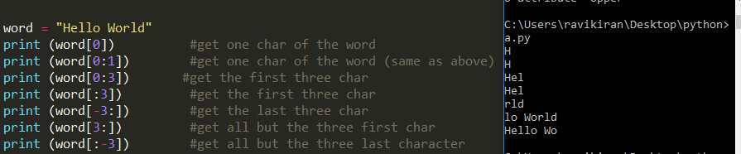
String Manipulation
Replace:
Slicing :
Use [ # : # ] to get set of letter Keep in mind that python, as many other languages, starts to count from 0.

Slide 7


String Manipulation
Startswith / Endswith:
Repeat Strings & Replacing:

Slide 8

String Manipulation
Reversing:
Strip:
Python strings have the strip(), lstrip(), rstrip() methods for removing any character from both ends of a string.
If the characters to be removed are not specified then white-space will be removed.
strip() #removes from both ends
lstrip() #removes leading characters (Left-strip)
rstrip() #removes trailing characters (Right-strip)

Slide 9
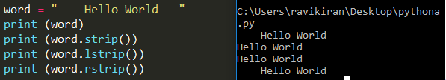
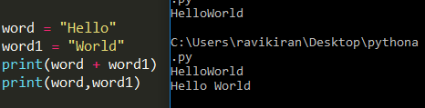
String Manipulation
Concatenation:

Slide 10
String Manipulation
Others:
word.isalnum() #check if all char are alphanumeric
word.isalpha() #check if all char in the string are alphabetic
word.isdigit() #test if string contains digits
word.istitle() #test if string contains title words
word.isupper() #test if string contains upper case
word.islower() #test if string contains lower case
word.isspace() #test if string contains spaces
word.endswith('d') #test if string ends with a d
word.startswith('H') #test if string starts with H

Slide 11
Assignment - 4
Write a Python program to calculate the length of a string.
Write a Python program to count the number of characters (character frequency) in a string. Sample String : google.com' Expected Result : {'o': 3, 'g': 2, '.': 1, 'e': 1, 'l': 1, 'm': 1, 'c': 1}
Write a Python program to get a single string from two given strings, separated by a space and swap the first two characters of each string
Sample String : 'abc', 'xyz' Expected Result : 'xyc abz‘
Write a Python program to remove the characters which have odd index values of a given string.
5. Write a Python program to check whether a string starts with specified characters.

